Slide 1
Against BUBBLE
GREEK REPUBLIC
MINISTRY OF EDUCATION AND RELIGION AFFAIRS ----
REGIONAL DIRECTORATE OF PRIMARY AND SECONDARY EDUCATION OF THESSALY
Against Bullying
01.09.2019 – 31.08.2021
Key Action 2: Strategic partnerships for school Education
Id: 2019-1-IT02-KA201-062355

Slide 2
1. Spain 2. Greece 3. Poland 4. Italy 5. Portugal
PROGRAM PARTNERS

Slide 3
PROGRAM PARTNERS
Except from the P.D.E.TH the following organizations participate to the program:
TUCEP - Tiber Umbria Comett Education Program, Italy (Program Coordinator),
Educational Association of Universities and Businesses of Umbria
Association Cultural Euroaccion Murcia, Spain,
Cultural Association, non-governmental organization for learning, professional and personal development of young people
IES Eduardo Linares Lumeras, Spain,
Public Organization of Education, Training and Employment in the region of Murcia
DIMITRA Ekpaideutiki Simvouleutiki, Greece,
Training and Counseling Organization
Wyzsza Szkola Biznesu I Nauk o Zdrowiuw, Poland,
Educational Institute of Health Sciences and Entrepreneurship
Instituto Comprensivo Peruzia , Italy,
Institute of Inclusive Education in Perugia
Agrupamento de Escolas Ferreira de Castro, Portugal,
School Complex
Associazione COAT - Centro Orientamento Ausili Tecnologici Onlus, Italy,
Center for Orientation of Technological Assistance
Giunti O.S. Psychometrics SRL, Italy,
Publishing House of Psychodiagnostic Tools, in Florence.

Slide 4
GENERAL FRAMEWORK OF THE PROGRAM
Bullying is a phenomenon that nowadays has reached alarming proportions in all European countries
Many studies have been done on the dimensions of this phenomenon and its numerous effects on students
Common finding of all studies is that this phenomenon is difficult to be controlled and prevented, mainly because very often students avoid reporting episodes of bullying for fear of provoking reactions

Slide 5
GENERAL FRAMEWORK OF THE PROGRAM
Managing bullying behaviors is even more difficult for children with Autism Spectrum Disorder (ASD) if they do not have the appropriate tools to recognize them and because of the lack of an organized supportive social network
The few studies existed on this subject show that the peculiarities of these children make them ideal victims, so that, compared to other students, they are four times more likely to be bullied in the school environment
More and more European countries are trying to adopt an integration education policy, but firstly they have to create a safe and appropriate environment for every pupil

Slide 6
OBJECTIVES OF THE PROGRAM
To prevent but also to treat cases of bullying towards students aged 10-14 with Autism Spectrum Disorder (ASD) - mainly with high-functioning autism
To socially integrate students with autism spectrum disorder in the school and social environment, in order to reduce and prevent the numerous episodes of bullying against this vulnerable group
To involve all the main factors that frame the school and family life of children with ASD (Technical and Auxiliary Staff, Students, Parents and Teachers) in order to achieve their school and social integration
To achieve the expansion of the program’s results by including not only students with high functional autism but also all students being daily victims of bullying for different reasons (social, cultural or other)

Slide 7
MEANS TO ACHIEVE THE OBJECTIVES
Needs survey through questionnaires structured for students, parents, teachers and special education staff
Creation of a Toolbox that will allow the detection and diagnosis of Bullying and then the therapeutic intervention
Creation of good practices that can be adopted by European countries in order to properly combat the various types of discrimination
Educational Activities: Teaching Methods Based on Active Involvement & Dramatization (Gestalt Method)
A printed publication: a guide about the bullying situation in partner’s countries translated in Greek language

Slide 8
INTELLECTUAL OUTPUTS
IO1: NEEDS ANALYSIS & FIELD RESEARCH
Conducting research regarding the theories, practices and policies applied in our country about bullying
Distribution of questionnaires to investigate the needs, knowledge & experiences regarding bullying towards children with ASD to:
a. teachers
b. support staff
c. parents
d. students
Writing a transnational study utilizing all the above data of the research and drawing conclusions indicative of the attitude of those involved in the issue of bullying towards students with ASD, based on statistical data

Slide 9
INTELLECTUAL OUTPUTS
IO2: TRAINING COURSE MATERIALS
Educational Activities: Teaching methods based on Active participation of all involved & Dramatization (Gestalt method)
IO3: Against Bubble TOOLKIT
Creation of a Toolbox for the detection, diagnosis of Bullying and the relevant therapeutic intervention
IO4: PEDAGOGICAL MODEL
Good practices that are successfully applied in European countries to combat discrimination and to ensure the integration of all students in school and social context

Slide 10
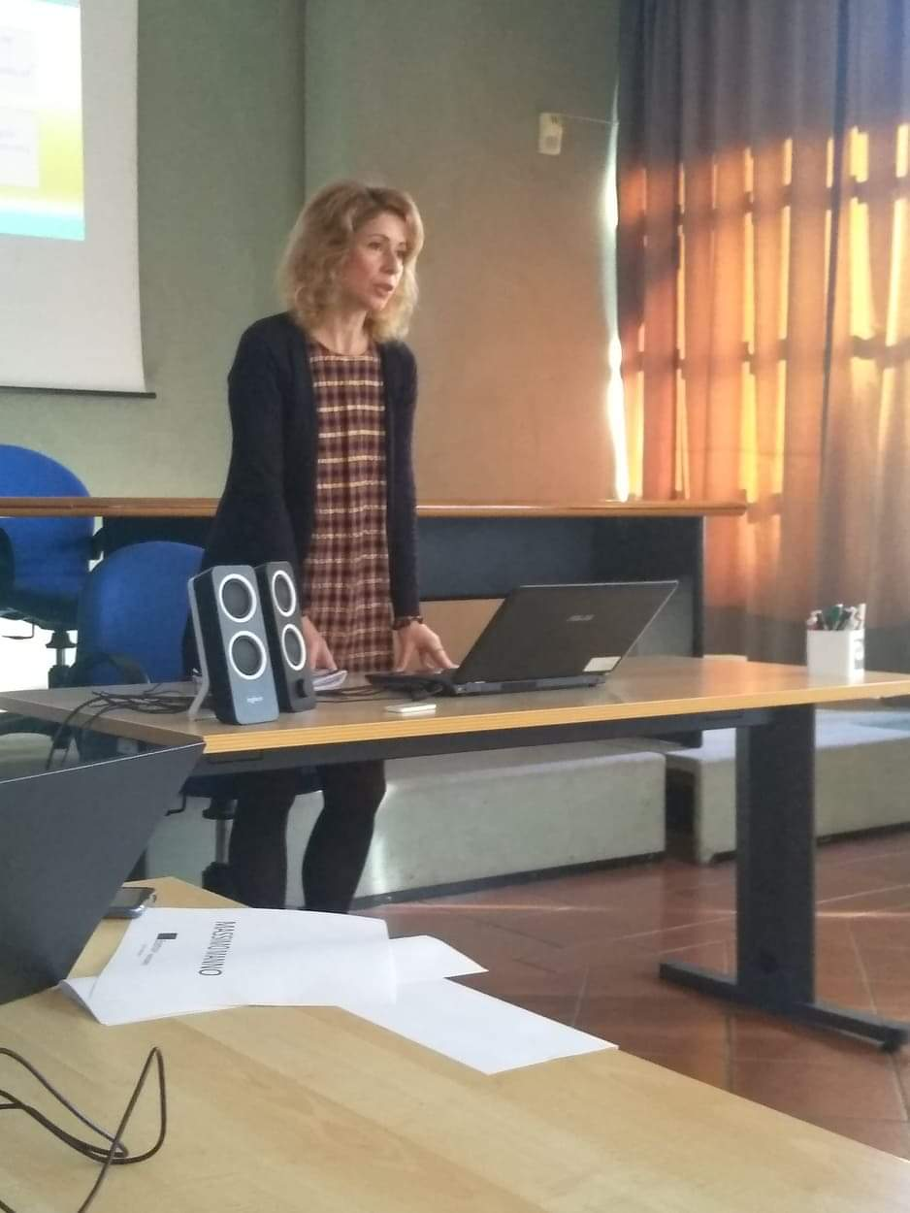
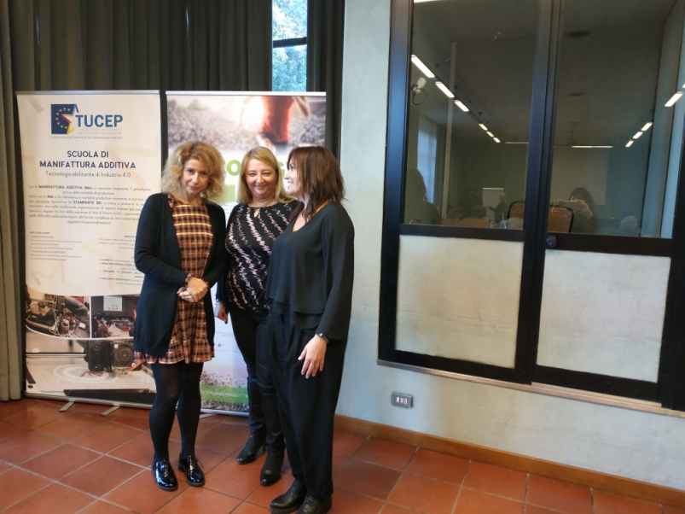
Bubble – KICK OFF MEETING IN PERUGIA

Slide 11
